Slide 1
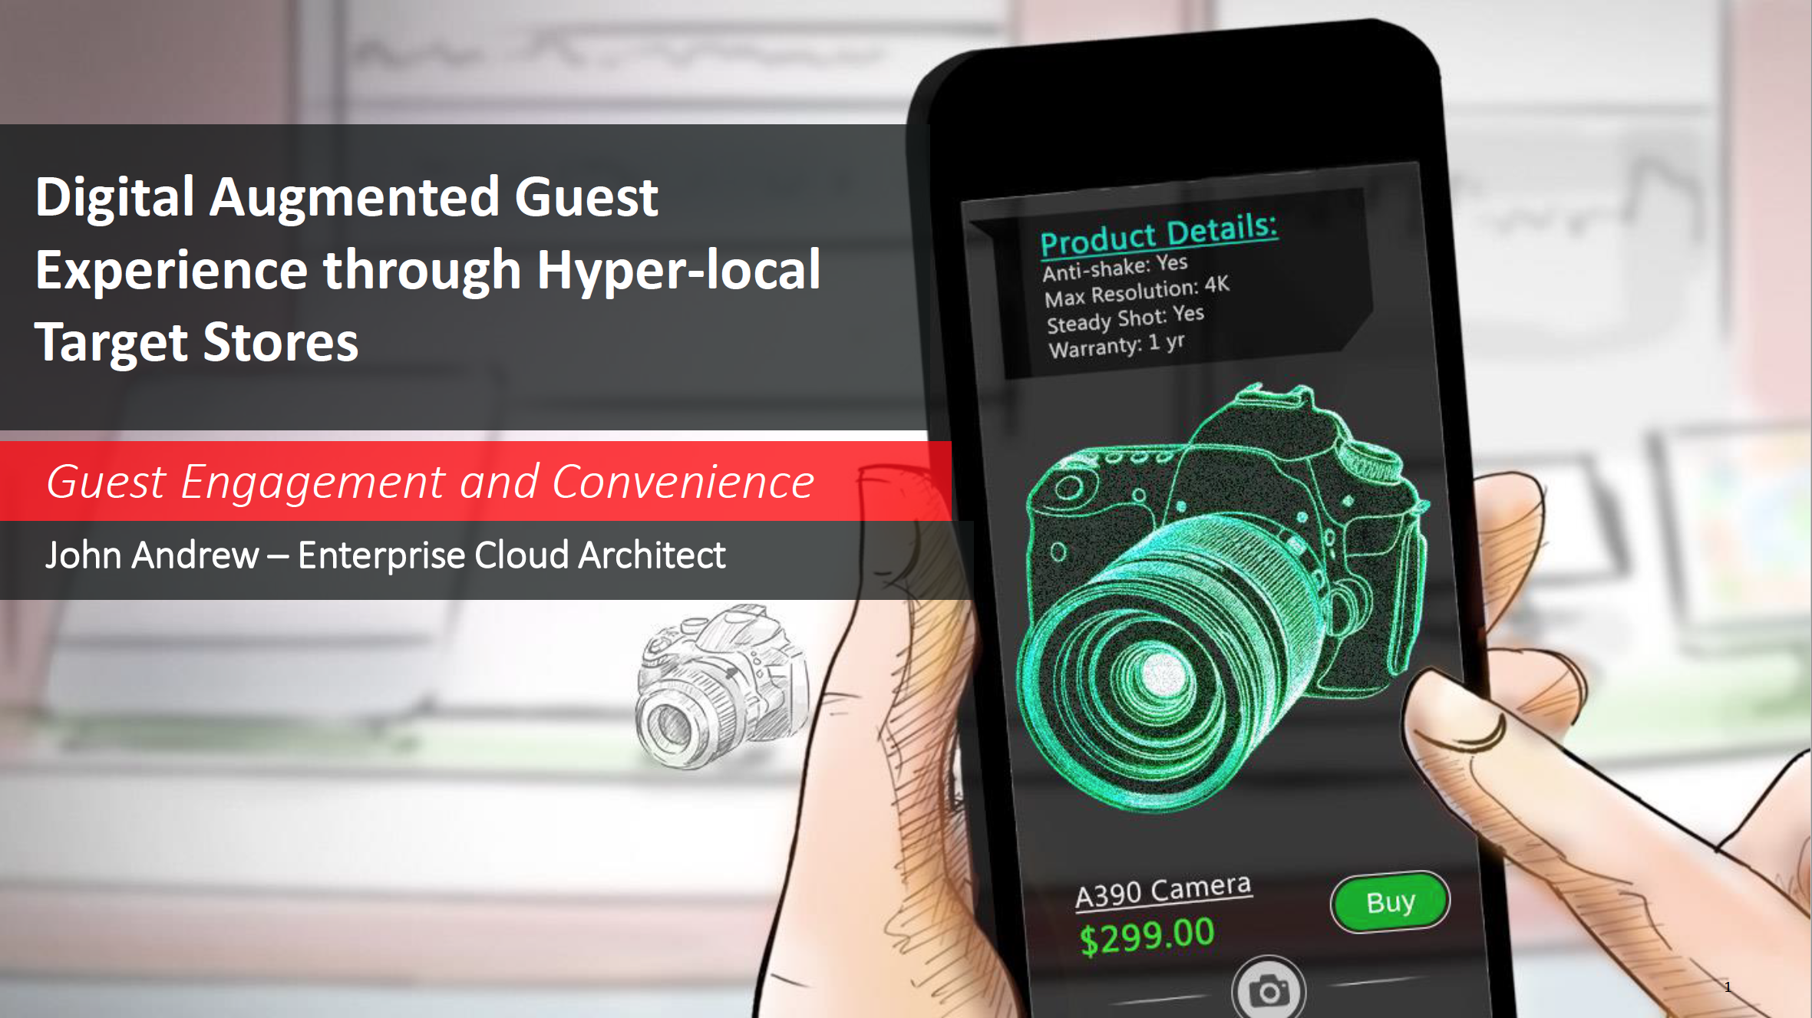

Slide 2
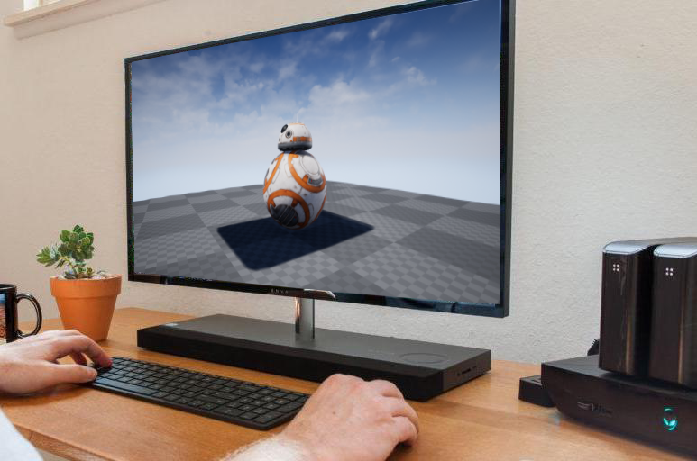





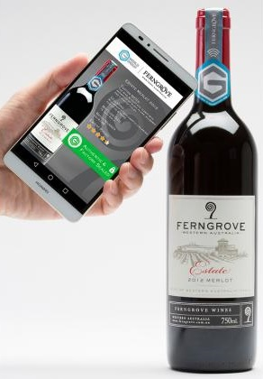





Notional Architecture – Cloud Services
Client Devices
Oracle Cloud Infrastructure
Managed File Transfer
Compute – CPU
Artificial Intelligence
Mobile Cloud
Enterprise
Target
IBCS (chatbots)
API Gateway
DBCS
Compute – GPU
Object Storage
Virtual Reality
MCS
Consumer
Notes:
3 Actors
Customer
Loan Officer
On boarding System

Slide 3


Data Set Preparation Stage
Retailer sends POST request to REST API on OCI – CPU with 3D model of product
Sends model data to OCI – GPU
Executes AR data generation script on OCI – GPU
Stores training data in OCI – Object Storage using OCI – API
Flask API
Managed File Transfer
Virtual Reality
Target Device
Compute – CPU
Compute – GPU
Object Storage
OCI – API
Notes:
3 Actors
Customer
Loan Officer
On boarding System

Slide 4
AI Model Training Stage
Splits image data into train and test data sets
Generates train and test TFRecord files
Generates inference graph with ML training script
Sends output inference graph back to OCI – CPU
Flask API
OCI – GPU
Artificial Intelligence
Compute – CPU
Object Storage
OCI – API
Notes:
3 Actors
Customer
Loan Officer
On boarding System

Slide 5
AI Inferencing Stage
Consumer sends POST request to REST API on OCI – CPU with product image
ML model references the latest inference graph and returns the predicted product label
Product label is used to index OCI – Database for product data
Product data is sent to mobile app for AR-UI and chatbot
Flask API
Compute – CPU
Artificial Intelligence
IBCS (chatbots)
OCI – API
DBCS
MCS
Consumer Device
Mobile Cloud
Enterprise
Notes:
3 Actors
Customer
Loan Officer
On boarding System

Slide 6


GPU Powered Recognition Demo and Chatbots
The following is a demonstration of a front end application that interfaces with a Object Recognition API in conjunction with ARKit
This app also showcases the ability to interface with Oracle Intelligent Bot Services
Object Recognition API
Client Front End with AR Kit
After Receiving the result, Chatbot will be queried

Slide 7
Agenda
1
Introduction
Platform Overview
Object Recognition Architecture
Demo
Q&A
2
3
4
5

Slide 8
PATTERN 1 - OBJECT RECOGNITION WITH TARGET PRODUCT IMAGE FILES
Meridiun Demo flow slide

Slide 9
PATTERN 2 - OBJECT RECOGNITION WITH TARGET 3D PRODUCT MODELS
Oracle Demo flow slide

Slide 10
Agenda
1
Introduction
Platform Overview
Object Recognition Architecture
Demo
Q&A
2
3
4
5

